Slide 1
Electric Vehicle Dataset Analysis
Insights into EV Adoption, Range, and Trends

Slide 2
Overview of the Analysis
This presentation provides insights from an Electric Vehicle (EV) dataset.
The dataset includes information on vehicle registrations, makes, models, and electric range.
Purpose: To analyze trends in EV adoption, electric range improvements, and distribution across different regions.
The analysis will help stakeholders like manufacturers, policymakers, and consumers make informed decisions about the EV market.

Slide 3
Dashboard Summary
Average Electric Range: 67.86 KM
Total Vehicles Analyzed: 150,450 vehicles
Breakdown of Vehicle Types: - BEV
(Battery Electric Vehicle): 78%
PHEV (Plug-in Hybrid Electric Vehicle): 22%
This summary provides a snapshot of the dataset, helping to understand the composition and performance of EVs in the market.

Slide 4
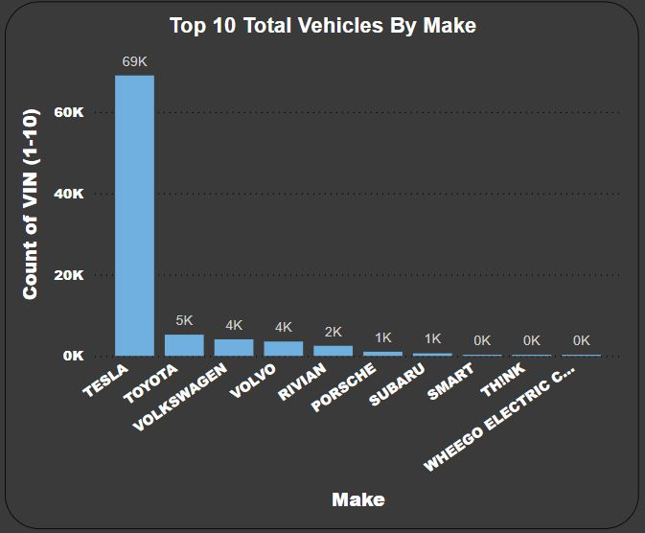
Top 10 EV Manufacturers by MAKE

Slide 5
Top 10 EV Manufacturers by MAKE
Tesla leads the EV market with 69,000 vehicles, making it the dominant manufacturer.
Other significant players include:
- Nissan: 13,000 vehicles
- Chevrolet: 12,000 vehicles
- Ford: 8,000 vehicles
This chart shows that Tesla's dominance is not just in individual models but across the entire electric vehicle landscape.

Slide 6
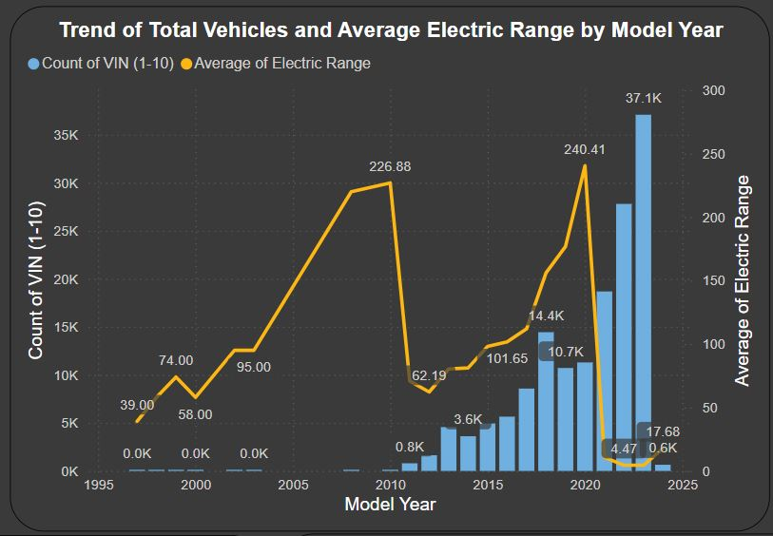
Trend of Total Vehicles and Average Electric Range by Model Year

Slide 7
Trend of Total Vehicles and Average Electric Range by Model Year
EV adoption has grown significantly, especially after 2015, with a steep rise in the total number of vehicles.
The average electric range of EVs has also improved year over year, peaking in recent years due to advancements in battery technology.
These trends indicate that electric vehicles are becoming more practical for daily use, with improved range and broader adoption.

Slide 8
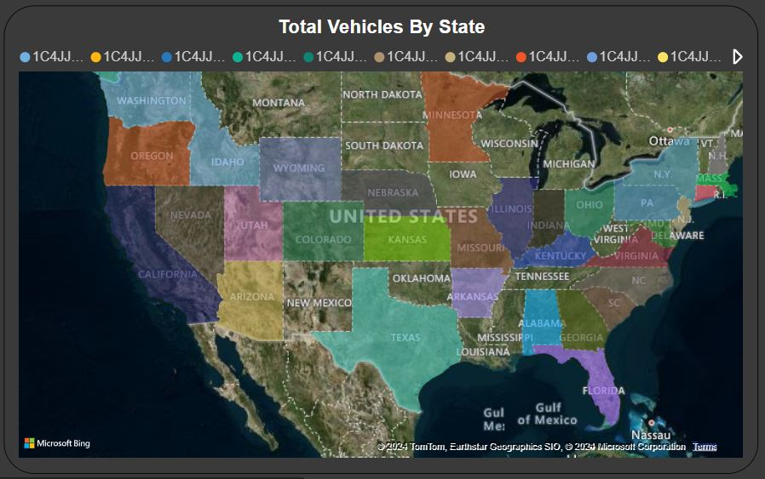
Distribution of Electric Vehicles by State

Slide 9
Distribution of Electric Vehicles by State
The filled map shows the distribution of electric vehicles across different states.
California leads in EV adoption due to strong government incentives, infrastructure development, and a higher level of consumer interest.
States in the Midwest and South show lower adoption rates, which may indicate the need for increased investment in charging infrastructure and incentives.

Slide 10
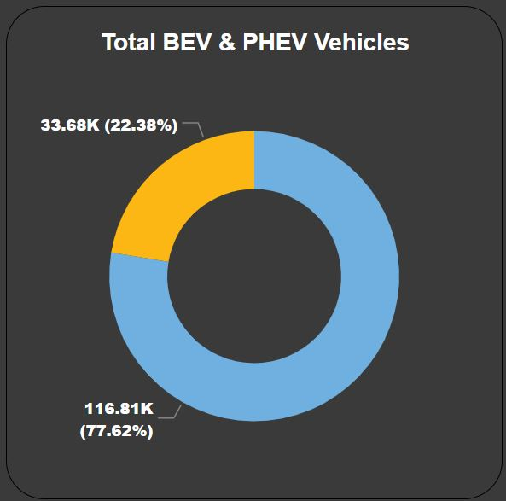
BEV vs PHEV Breakdown

Slide 11
BEV vs PHEV Breakdown
Battery Electric Vehicles (BEVs) represent 78% of the total EV population, showing a growing consumer preference for fully electric vehicles.
Plug-in Hybrid Electric Vehicles (PHEVs) make up 22%, indicating that there is still interest in hybrid solutions, especially in regions where charging infrastructure may be lacking.
This breakdown helps us understand the types of EVs that are popular and what that means for the future of the market.

Slide 12
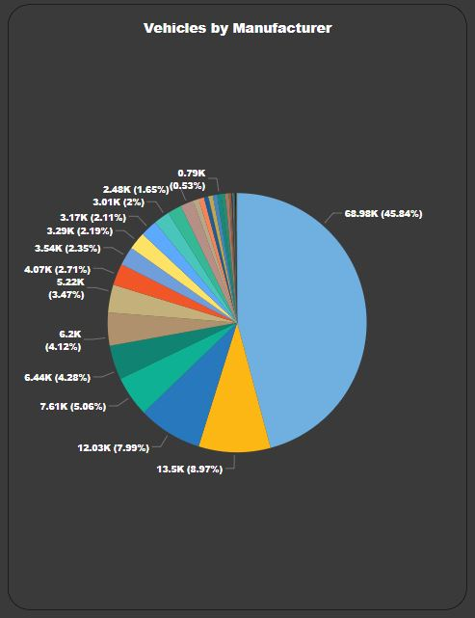
Top EV Models by Manufacturer

Slide 13
Top EV Models by Manufacturer
Tesla's Model Y (28,500 vehicles) and Model 3 (27,700 vehicles) are the top two most popular electric vehicles.
Other notable models include:
- Nissan Leaf: 13,000 vehicles
- Chevrolet Volt: 12,000 vehicles
The success of Tesla's models highlights the brand's leadership in producing high-performing, desirable electric vehicles.

Slide 14
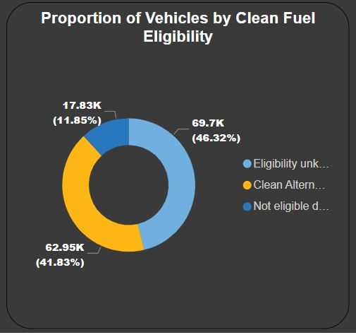
Proportion of Vehicles by Clean Fuel Eligibility

Slide 15
Proportion of Vehicles by Clean Fuel Eligibility
46.33% of vehicles in the dataset are eligible for clean fuel incentives, making them attractive to environmentally conscious consumers and businesses.
41.82% are not eligible, which might suggest areas where manufacturers could improve or where additional policy intervention could help.
11.85% have unknown eligibility status, indicating gaps in data or the need for further clarity in incentive programs.

Slide 16
Conclusion & Insights
Tesla dominates the EV market, both in terms of manufacturer and vehicle models.
EV adoption has increased significantly since 2015, driven by better technology and increased consumer awareness.
The average electric range of vehicles is improving, making EVs more practical for long-distance use.
Geographic distribution shows a strong preference for EVs in states like California, but there are significant gaps in other regions.
These insights suggest that while EV technology and adoption are growing rapidly, there is still room for improvement in infrastructure and policy to support wider adoption.

